Slide 1


ECEN 403 Midterm Presentation
Team 61:
Human Activity Radar Detector (HARD) JJ Chirat , Preston Bowyer, William Jachimiak, Aiden George
TA: Roman Venegas
Sponsor: Professor Arya Menon

Slide 2

Human Radar Detector
Problem statement:
Injury from falling is common in assisted living and can lead to significant issues
Traditional camera based sensors violate individual’s right to privacy
Our Solution:
A human fall detector that uses short wave radio and sends alerts via an app
These detectors can be used in more sensitive areas and prevent privacy violations

Slide 3
System Overview
Radar Detection Unit
Power Supply
(Aiden George)
Millimeter Wave Radar Unit
End User
Microcontroller
Mobile Application
(Preston Bowyer)
AI Classification
(JJ Chirat)
PCB
(William Jachimiak)
Notes:
Cloud server and database

Slide 4
Radar Detection Unit
Power Supply
Millimeter Wave Radar Unit
Microcontroller
End User
Mobile Application
AI Classification
PCB

Slide 5
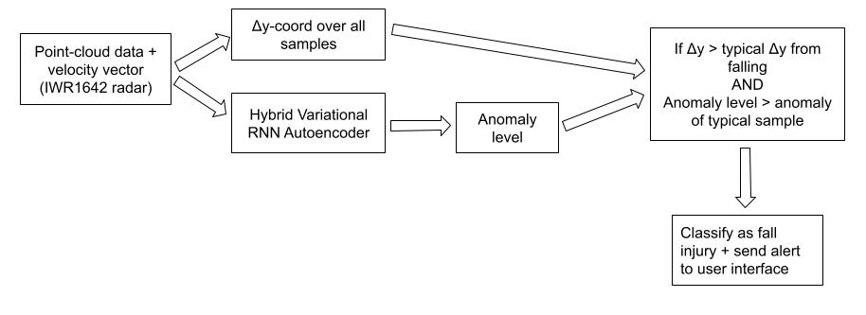
Radar Signal ML – JJ Chirat
Analyzes radar reflections and determines whether they constitute a fall injury
ML algorithm will be developed in Python, using libraries such as scikit and tensorflow
Must be able to distinguish fall injury from sitting, laying on bed, etc., and must be trained on data which will not be modified in the future
Takes processed point-cloud data format from radar chip, ML algorithm on MCU will classify the signal, and transmit if fall injury is detected to user through app interface

Slide 6
MCU and PCB – William Jachimiak
Radar Module
Radar Data via SPI
Integrated WIFI/Cloud
MCU
User End App
Gets data from radar sensor and runs the ML system and sends alerts out via WIFI to the app
PCB will be designed using Altium and will house the ESP32-S3 MCU which will be wired to the radar development board and power system
Needs to be able to run on on battery power for extended periods
Needs to be powerful enough to run an ML algorithm

Slide 7
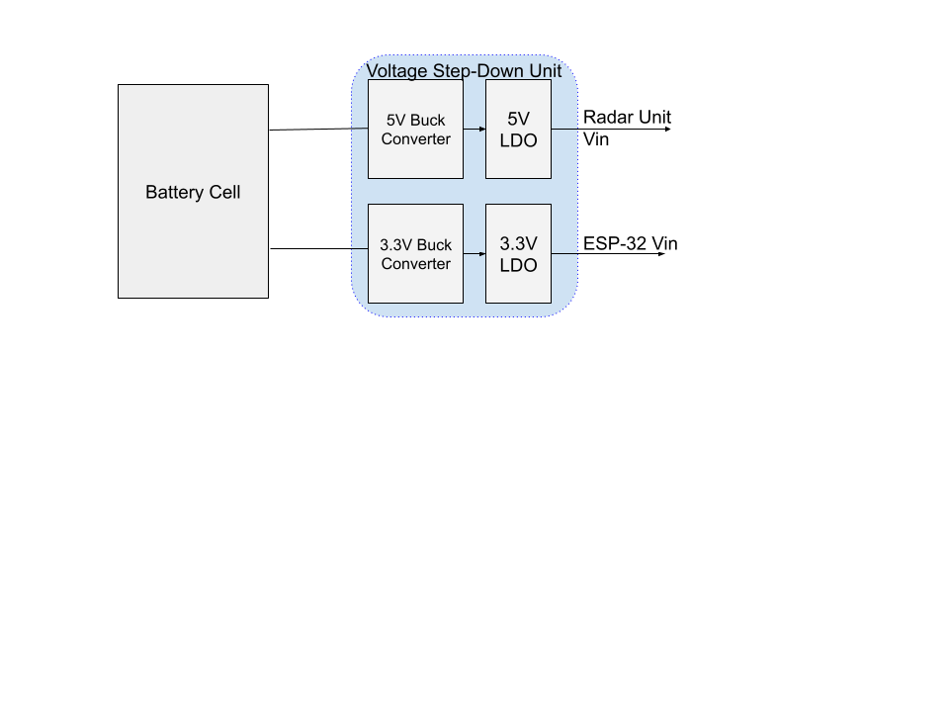
Power Supply – Aiden George
Provides power to the Radar module and MCU
Battery Powered: requires a large enough age to power system for long times without user intervention
Efficiency: voltage step-down solution must be efficient both to converse battery life and reduce thermal effects
Design will be tested and validated in LTSpice before purchase of components

Slide 9
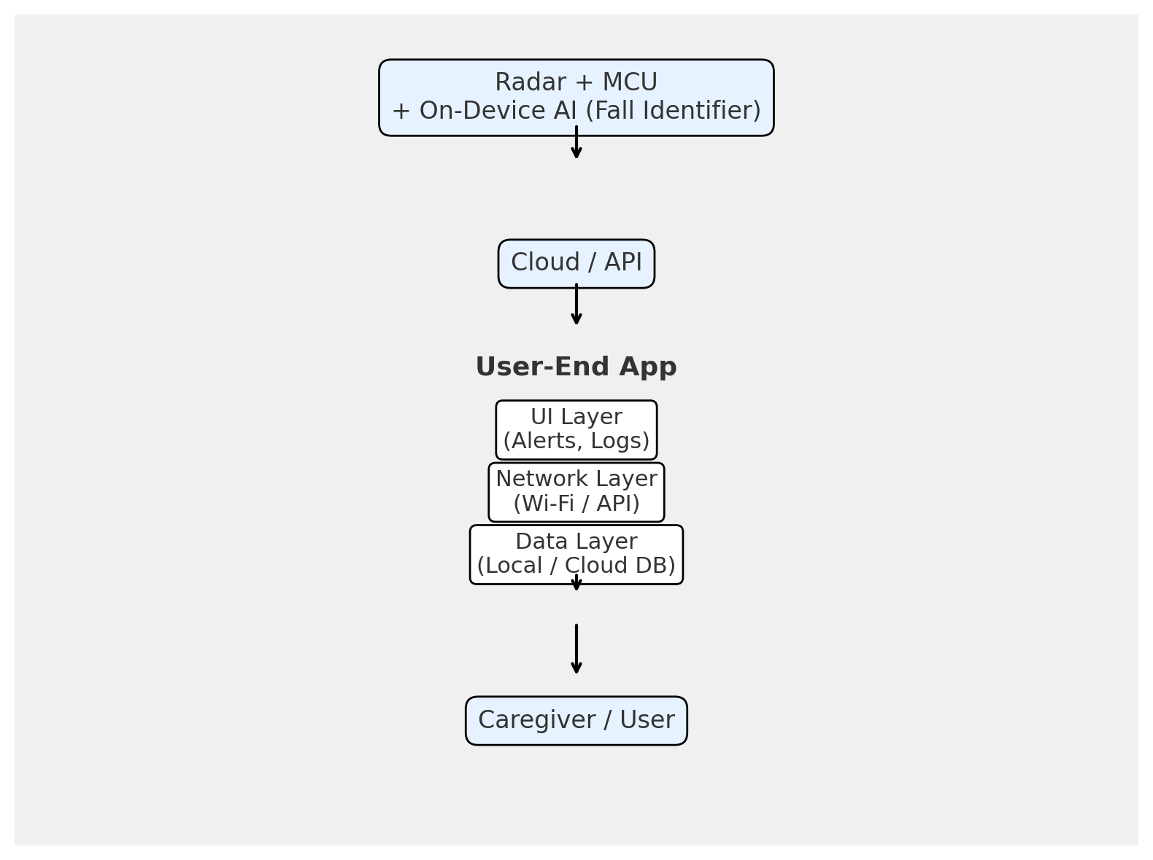
End-User App – Preston Bowyer
Purpose: User interface for system, real time alerting, fall event logging
Tools: Expo framework and React Native
Objectives: Simplistic UI, quick detection-to-alert time
Constraints: Cross Platform, low device load
Relation to Other Subsystems: MCU via detection events sent to cloud

Slide 10
Project Execution & Validation
 | 9/24 - today | 10/6 | 10/20 | 11/3 | 11/17
Radar Signal ML (JJ Chirat) | Found suitable example models on GitHub | Build foundations of ML algorithm | Have training data collected | Finish implementing model & training using collected data | Validate algorithm correctly classifies signals and transmits data to app
MCU and PCB (William Jachimiak) | Acquired dev board and installed Altium | Design initial PCB floor plan | Test MCU to radar interface, Finish PCB design | Test MCU on PCB | Validate Radar to MCU to WiFi/Cloud to App data flow,
Power Supply Aiden George | Final module choice for Radar and MCU finalized | Design initial power supply circuit | Test and finalize design in LTSpice | Validate Power Supply for both MUC and Radar Module connection | Finish testing of reliability and endurance of final system
User-End App (Preston Bowyer) | Installed Expo and other necessary packages | Designed mock cloud backend completed, alert/notification and logging system started | Test Alert/notification and logging, Design statistical analysis on log data | Implement analysis on data for risk assessment, begin fine tuning user interface | Validate cloud data to alert system, final adjustments to logging system and UI

